Slide 1
Lecture 10: Configuration Management, Integration, and Builds
based on Chapter 11

Slide 2
I. Background
A software project produces many items - programs, documents, data, manuals
All of these can be changed easily – need to keep track of the state of items
Software Configuration Management (SCM): Systematically control the changes
  Focus on changes during normal evolution; requirement changes will be handled separately
CM requires discipline as well as tools
Other Processes

Slide 3
Background
SCM often independent of development process
  Development process looks at macro picture, but not on changes to individual items/files
As items are produced during the development process, it is brought under SCM
SCM controls only the products of the development process
Other Processes

Slide 4
Configuration Management
What does configuration management manage?
  Software artifacts
  Change control
  System builds

Slide 5
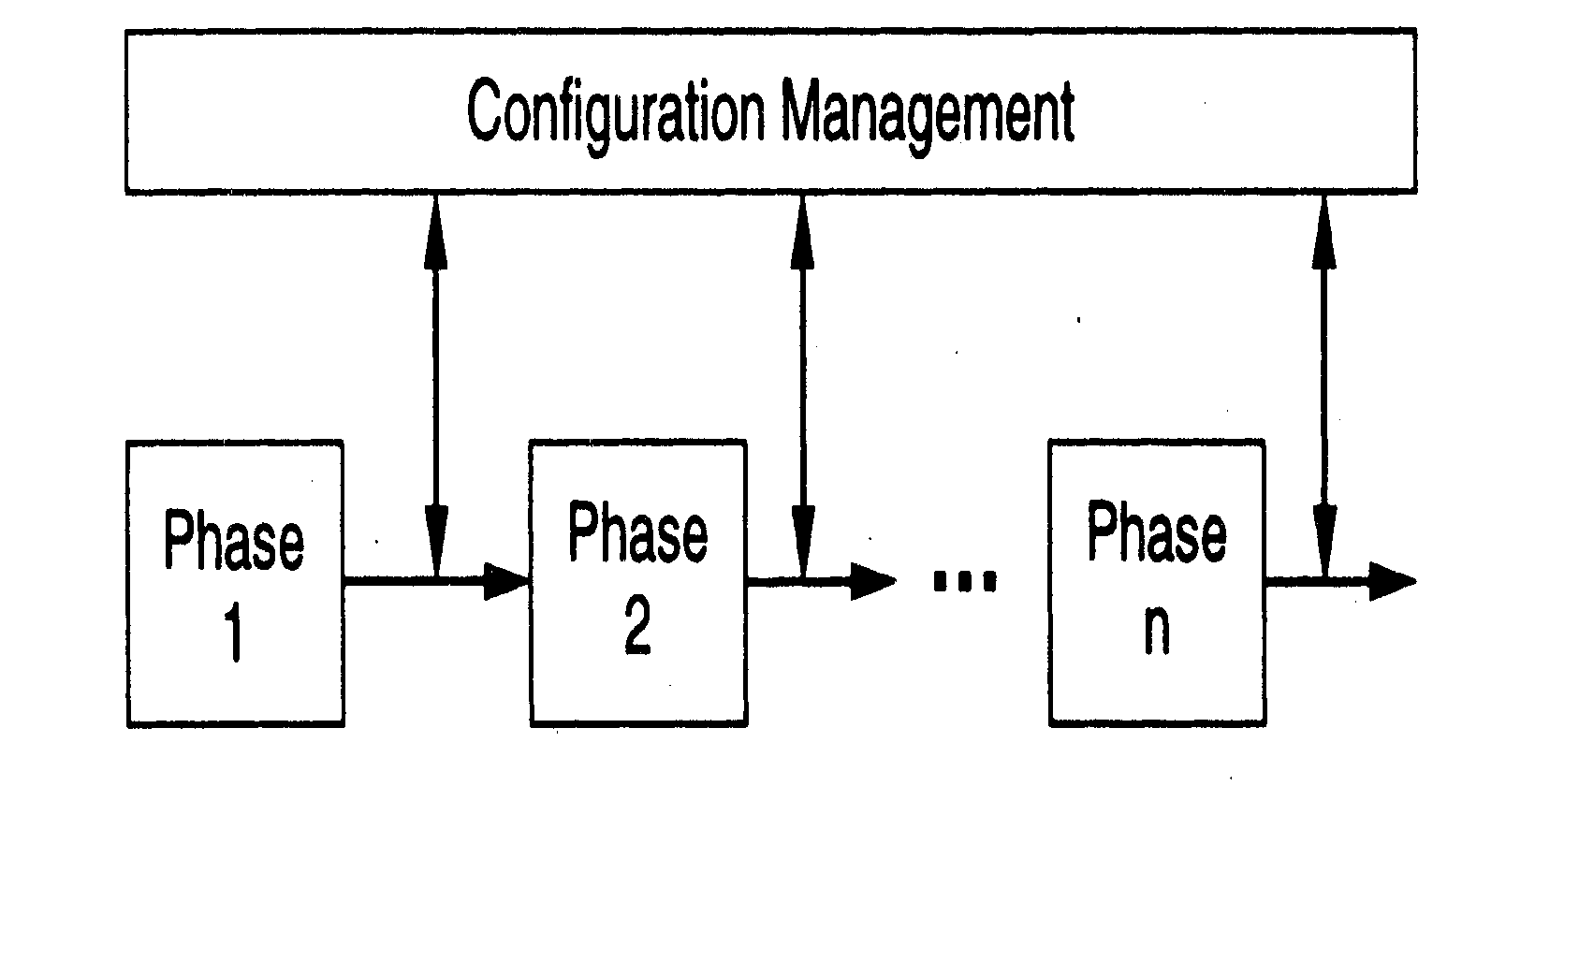
SCM Process and Development process
Other Processes

Slide 6
Need for CM
To satisfy the basic project objective of delivering the product to the client
  What files should comprise the product
  What versions of these files
  How to combine these to make the product
Just for this, versioning is needed, and state of different items has to be tracked
There are other functions of CM
Other Processes

Slide 7
Functionality Needed
Give states of programs
Give latest version of a program
Undo a change and revert back to a specified version
Prevent unauthorized changes
Gather all sources, documents, and other information for the current system
Other Processes

Slide 8
CM Mechanisms
Configuration identification and baselining
Version control
Access control
These are the main mechanisms, there are others like naming conventions and directory structure
Other Processes

Slide 9
Configuration Items
SW consists of many items (some artifact)
In CM some identified items are placed under CM control
Changes to these are then tracked
Periodically, system is built using these items and baselines are established
Baseline – logical state of the system and all its items; is a reference point
Other Processes

Slide 10
Def: Software Configuration Management
The management of all the pieces and parts of
artifacts produced as a part of the software
development and software support activities
e.g.
- requirements specifications
- design documentation
- source code
- test scenarios
- executable code
- data base tables
- initialization data
- customer problem calls
- problem fixes
- user documentation

Slide 11
Managing the Software Artifacts
Interested in :
  Relating the artifacts
  (e.g.)
      - by “usage” relationship
      - by packaging into a “release” relationship
      - by promoting into different test bucket level
  Multi-versioning of each artifact
  - Access and protection of each artifact

Slide 12
An Example : Inter-Artifacts Relationship Matrix
 | Requirements Elements | Design Elements | Code Logic | UI Screens | DB tables | Initialization data | Test cases
Requirements Elements |  | X | X | X |  |  | X
Design Elements | X |  | X | X | X | X
Code Logic | X | X |  | X | X | X | X
UI Screens | X | X | X |  |  |  | X
DB tables |  | X | X |  |  | X
Initialization data |  | X | X |  | X |  | X
Test cases | X |  | X | X |  | X
The artifacts are not single dimensional in that they may be related to
each other, where the relationship may be one is an input to another or
One is used by another.

Slide 13
Intra – relationship: where there are multiple country versions of requirements
Inter- relationship: where design is the input to code
Requirements
Design
Code
Test Cases
general
general
general
general
French
French
French
French
Japanese
Japanese
Japanese
Japanese
Brazilian
Brazilian
Brazilian
Brazilian

Slide 14
Promotion of Artifacts: An Example of Configuration Management Influenced by Testing Process
Release
Promote
Promote
System Tested
“Golden” Copy
.
.
.
.
Component
Tested; Ready
for System Test
Promote
Functionally
Tested; Ready
for Component
Test
Integrated
for Functional
Test
Unit Tested
Private Copies

Slide 15
Version and access control
Key issues in CM
Done primarily on source code through source code control systems, which also provide access control
Allows older versions to be preserved and hence can undo changes
Eg: CVS and VSS are commonly used; Clear case for large projects
Other Processes

Slide 16
Version and Access Control
When programmer developing code – is in private area
When code is made available to others, it goes in an access-controlled library
For making changes to an item in library, it has to be checked out
Changes made by checking-in the item – versioning is automatically done
Final system is built from the library
Other Processes

Slide 17
Version/Access Control
Generally both version and access control done through CM tools like VSS, SCCS
Tools limit access to specified people - formal check in, check out procedures
Automatic versioning done when a changed file is checked-in
Check-in, check-out control may be restricted to a few people in a project
Other Processes

Slide 18
Code Changes and Versioning Example
Original
Module 1 – v0
Modified
Module 1 – v1
Modified 2nd time
Module 1 – v2
Modified 3rd time
Module 1 – v3

Slide 19
Some Aspects of Managing Software Parts Relationships
Link the versioning of code modules to design artifacts
Further add the relationship of requirements to design and code artifacts.
Now relate the test scenarios to these
Fold in the possibilities of multiple releases and the support of these multiple releases that can have fixes applied to them
Finally, consider these in terms of the world-wide market where we may have German version, Japanese version, French version, Chinese version, Brazilian version, etc.

Slide 20
Configuration Management Framework
In order to control all the pieces and parts of the software artifacts, we need two basic models
  Parts identification model (naming)
  Parts storage and access model

Slide 21
Sample Parts Identification model (naming)
A software artifact must be uniquely identifiable with a “name” composed of:
  PP : two position product code
  CC : two position country code
  RRR: three position release code
  VVV: three position version code
  TT : two position artifact type code
  FF : two position format code
A sample artifact identifier: PP.CC.RRR.VVV.TT.FF
where “.” Is used as the delimiter

Slide 22
Parts Storage and Access model for
Configuration Management
Parts Database
Parts
Control
System build
Individual
user
Individual
user
. . . .

Slide 23
Parts Storage and Access model for
Configuration Management
Basic functions:
  Create a part
  Delete a part
Access functions
  View a part
  Modify a part
  Return a part
Control and service functions
  Import part(s)
  Export part(s)
  List parts
  Set release or version numbers
  Increment release or version numbers
  Change part name, version, release, artifact type, etc
  Gather parts
  Merge into a part
  Promote parts
  compare parts
  Lock / unlock pars
  Where used and cross reference the parts

Slide 24
System Build with Configuration Manager
Construct a build (dependency) list
Compile
Link
Generating the required executables that are ready to run

Slide 25
Some Configuration Mgmt Tools
Tier 1 : Version control and change control:
  Revision control system (RCS)
  Source code control system (RCCS)
  Concurrent version system (CVS)
Tier 2: Builds
  Make utility
  Odin: similar to Make tool, not compatible
  Cons: Meant to be an improvement over Make
  Scons: Based on architecture of Cons
Tier 3: Configuration Management for large systems
  PVCS : ChangeMan (Serena)
  Clear Case (IBM)
  Visual SourceSafe (Microsoft)

Slide 26
Configuration Management Process
Other Processes

Slide 27
SCM Process and Development process
Other Processes

Slide 28
CM Process
Defines the activities for controlling changes
Main phases
  CM Planning
  Executing the CM process
  CM audits
Other Processes

Slide 29
CM Planning
Identify items to be placed under CM
Define library structure for CM
Define change control procedures
Define access control, baselining, reconciliation, procedures
Define release procedure
Other Processes

Slide 30
CM Audit
During project execution CM procedures have to be followed (e.g. moving items between directories, naming, following change procedures, …)
Process audit has to be done
CM audit can also check if items are where they should be
Other Processes

Slide 31
Summary – CM
CM is about managing the different items in the product, and changes in them
Developing a CM plan at the start is the key to successful CM
CM procedures have to be followed; audits have to be performed
Requires discipline and tools
Other Processes

Slide 32
Requirements Change Management Process
Other Processes

Slide 33
Background
Requirements change. At any time during the development
Changes impact the work products and the various configuration items
Uncontrolled changes can have a huge adverse impact on project in cost/schedule
Changes have to be allowed, but in a controlled manner
Other Processes

Slide 34
A Change Management Process
Log the changes
Perform impact analysis on the work products and items
Estimate impact on effort and schedule
Review impact with stakeholders
Rework the work products/items
Other Processes

Slide 35
Changes
Change often triggered by change request
Change request log keeps a record of requests
Impact analysis for a change request involves identifying the changes needed to diff items, and the nature of change
The impact of changes on the project is reviewed to decide whether to go ahead
Cumulative changes also often tracked
Other Processes

